Slide 1

Fabrication of graphitic-carbon suspended nanowires through mechano-electrospinning of photo-crosslinkable polymers
Osamu Katagiri-Tanaka A01212611@itesm.mx
Principal Advisor: Dr. Héctor Alán Aguirre Soto Co-advisor and Director of Program: Dra. Dora Iliana Medina Medina
25 Nov 2020

Slide 2
Agenda
Motivation & Problem Statement : n min
Objectives : n min
NFES literature review : n min
Rheology Analyses : n min
Fabrication & Characterization : n min
Future Work : n min

Slide 3
Motivation & Problem Statement

Slide 4
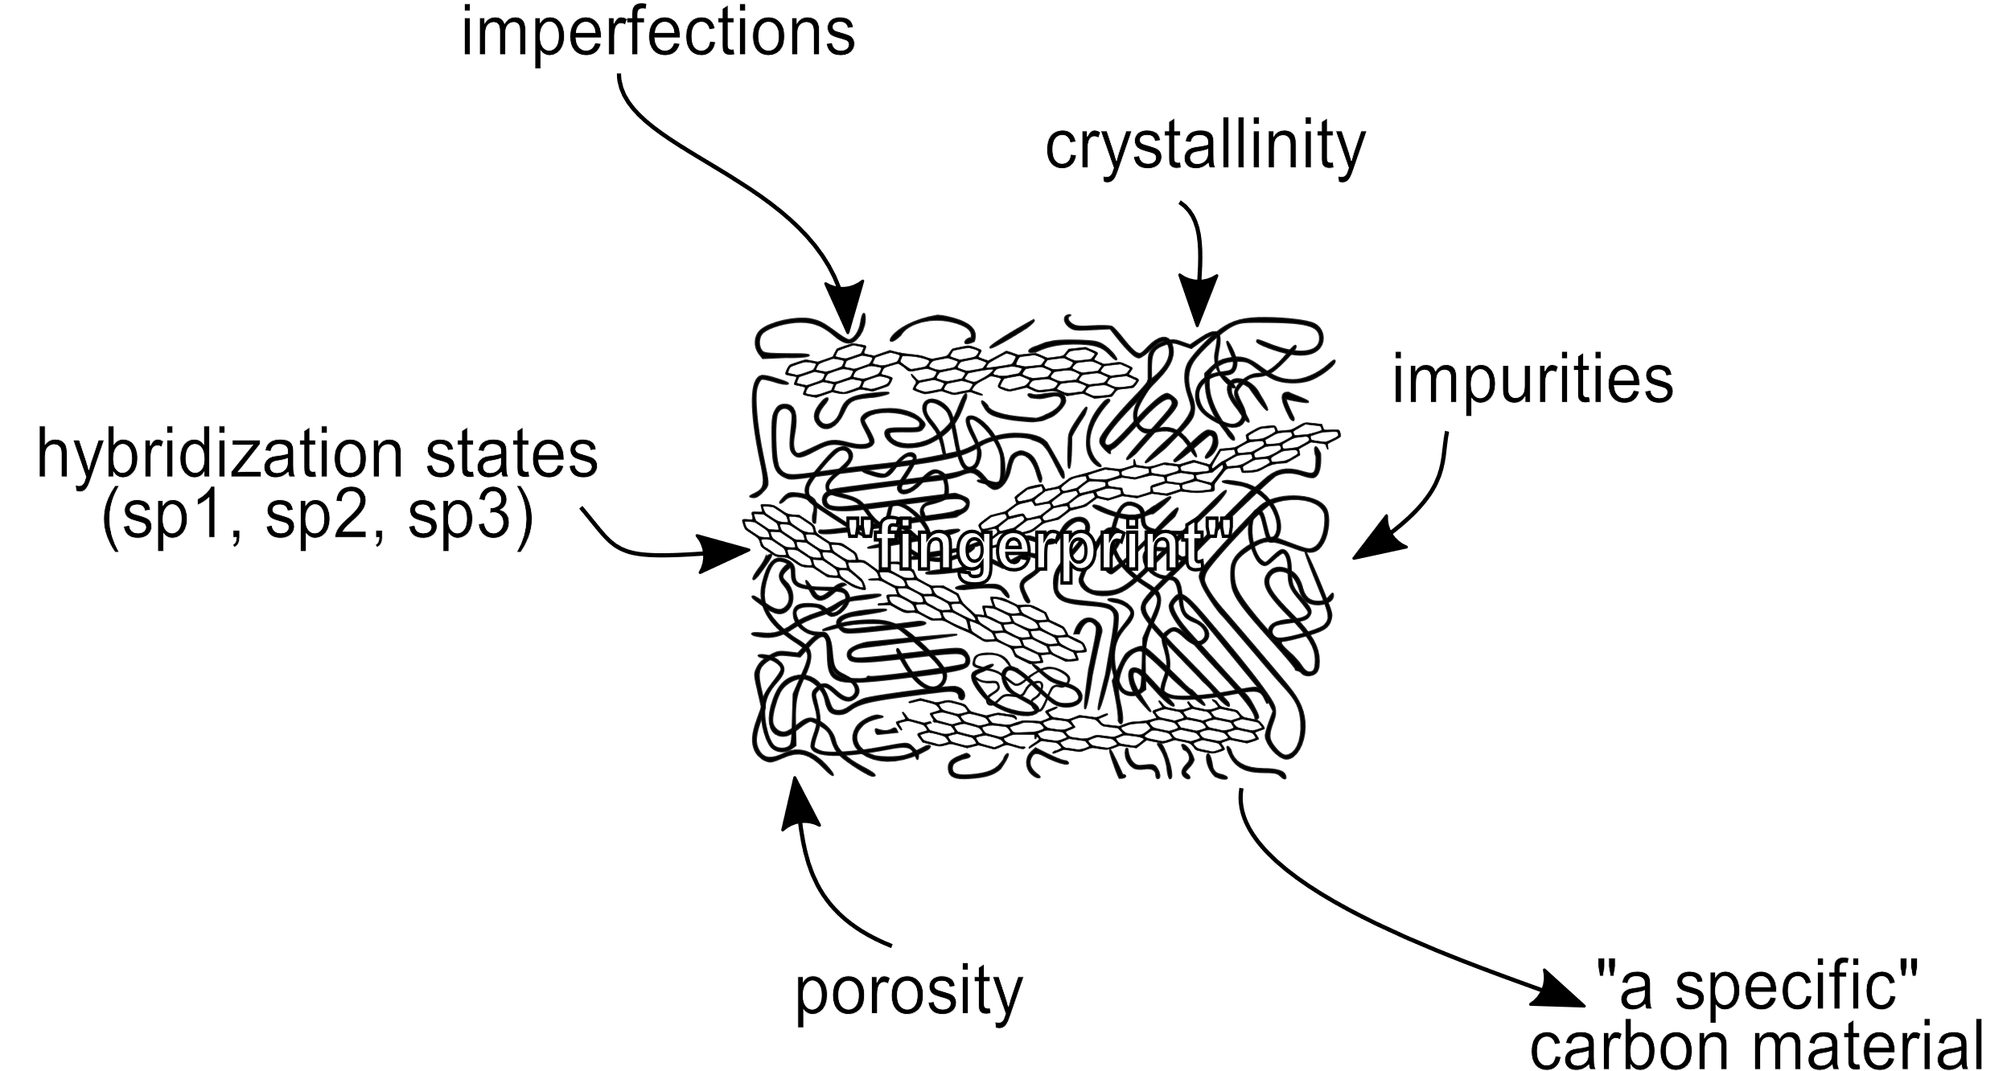
Carbon Based Nanomaterials (CBNs)
The crystallite size, molecular arrangement, and anisotropy determine the material’s properties.
The interminable collection of CBNs range from soft, conductive lubricants to very hard, low conductivity solids; and from black colour, bulks to transparent, disordered thin films
R.L. McCreery, Advanced Carbon Electrode Materials for Molecular Electrochemistry, Chem. Rev. 108 (2008) 2646–2687. https://doi.org/10.1021/cr068076m.
S. Beigi-boroujeni, O. Katagiri-tanaka, B. Cardenas-benitez, O. Sergio, A. Aguirre-soto, Pyrolytic Carbon from Novolac Epoxy Resin Compressed before Photocrosslinking and Pyrolysis, Mater. Today Proc. (2020).
Notes:
* Classification in a diagram with ranges and units (characterization techniques)

Slide 5
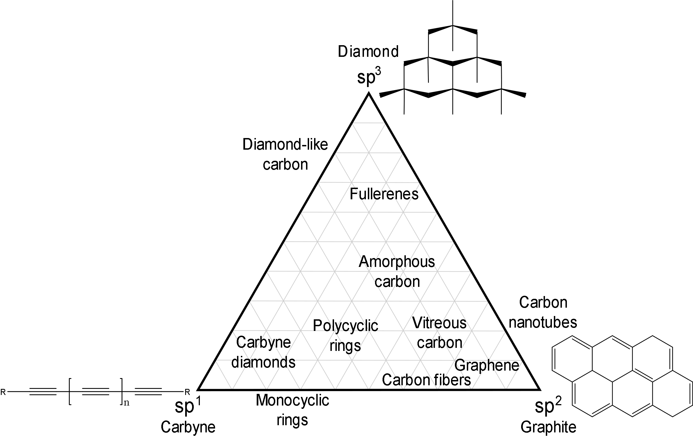
Carbon allotropes
R.B. Heimann, S.E. Evsvukov, Y. Koga, Carbon allotropes: a suggested classification scheme based on valence orbital hybridization, Carbon N. Y. 35 (1997) 1654–1658. https://doi.org/10.1016/S0008-6223(97)82794-7.
Е.А. Belenkov, Classification of carbon structures, in: Carbon Nanotub. Graphene, Chelyabinsk State University, Chelyabinsk, Russia, 2003: p. 5.
M. Fedel, Blood compatibility of diamond-like carbon (DLC) coatings, in: Diamond-Based Mater. Biomed. Appl., Elsevier, 2013: pp. 71–102. https://doi.org/10.1533/9780857093516.1.71.
M. Razeghi, Fundamentals of Solid State Engineering, Springer International Publishing, Cham, 2019. https://doi.org/10.1007/978-3-319-75708-7.
K. Alstrup Jensen, J. Bøgelund, P. Jackson, N. Raun Jacobsen, R. Birkedal, P. Axel Clausen, A. Thoustrup Saber, H. Wallin, U. Birgitte Vogel, Carbon nanotubes - Types, products, market, and provisional assessment of the associated risks to man and the environment, The Danish Environmental Protection Agency, 2015.

Slide 6
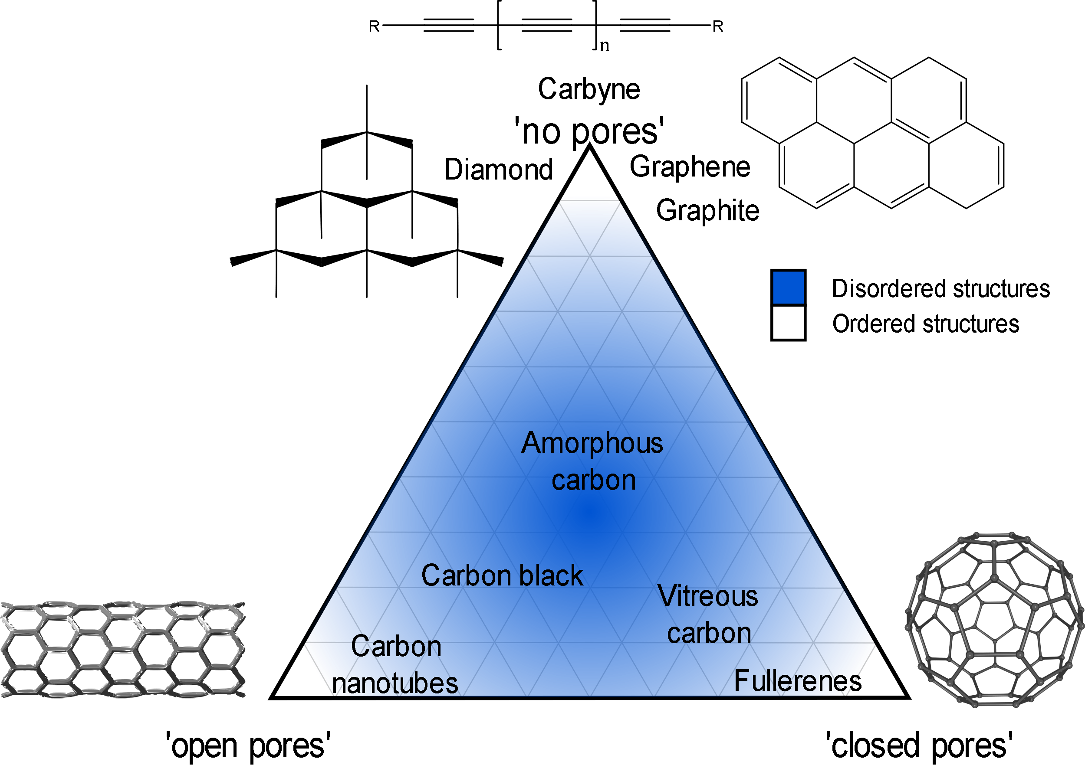
Carbon allotropes
R.L. McCreery, Advanced Carbon Electrode Materials for Molecular Electrochemistry, Chem. Rev. 108 (2008) 2646–2687. https://doi.org/10.1021/cr068076m.
S. Beigi-boroujeni, O. Katagiri-tanaka, B. Cardenas-benitez, O. Sergio, A. Aguirre-soto, Pyrolytic Carbon from Novolac Epoxy Resin Compressed before Photocrosslinking and Pyrolysis, Mater. Today Proc. (2020).
Harry Marsh. Introduction to Carbon Science. Vol. 46. 1. Elsevier, Apr. 1989, p. 43. ISBN: 9780408038379. DOI: 10.1016/C2013- 0- 04111- 4. URL: https: //linkinghub.elsevier.com/retrieve/pii/C20130041114.
Pierson Hugh. Handbook of Carbon, Graphite, Diamonds and Fullerenes. Elsevier, 1994, p. 419. ISBN: 9780815513391.
Notes:
Add Triangle diagram
Focus in GLC

Slide 7
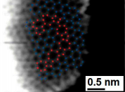
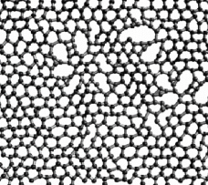
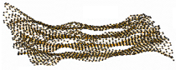
Glass-like Carbon
Attractive for its electrochemical stability, thermal resistance, electrical conductivity, biocompatibility and is gas impermeable.
It is used in the manufacture of semiconductors.
R.L. McCreery, Advanced Carbon Electrode Materials for Molecular Electrochemistry, Chem. Rev. 108 (2008) 2646–2687. https://doi.org/10.1021/cr068076m.
G. Speranza, The Role of Functionalization in the Applications of Carbon Materials: An Overview, C — J. Carbon Res. 5 (2019) 84. https://doi.org/10.3390/c5040084.

Slide 8


MicroChem’s SU-8 & Tokai’s recipe
Electrical resistivity, comparison:
highly oriented pyrolytic graphite (HOPG)
<
<
TOKAI Glassy carbon
SU-8 glass-like carbon
x10³
x4
Tokai’s recipe is a secret …
R.L. McCreery, Advanced Carbon Electrode Materials for Molecular Electrochemistry, Chem. Rev. 108 (2008) 2646–2687. https://doi.org/10.1021/cr068076m.
G. Speranza, The Role of Functionalization in the Applications of Carbon Materials: An Overview, C — J. Carbon Res. 5 (2019) 84. https://doi.org/10.3390/c5040084.
Notes:
* Focus in microchem

Slide 9
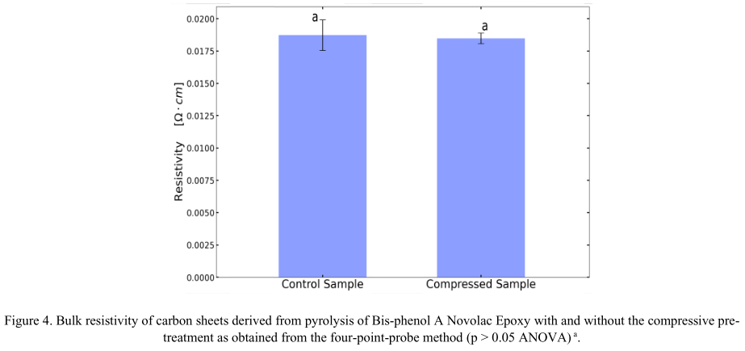
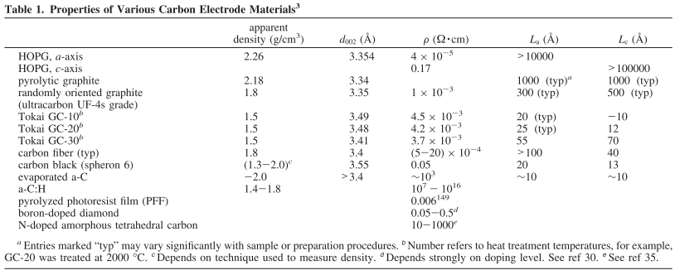
MicroChem’s SU-8 & Tokai’s recipe
SU-8
glass-like carbon resistivity:
<content> <key concept>
R.L. McCreery, Advanced Carbon Electrode Materials for Molecular Electrochemistry, Chem. Rev. 108 (2008) 2646–2687. https://doi.org/10.1021/cr068076m.
G. Speranza, The Role of Functionalization in the Applications of Carbon Materials: An Overview, C — J. Carbon Res. 5 (2019) 84. https://doi.org/10.3390/c5040084.

Slide 10
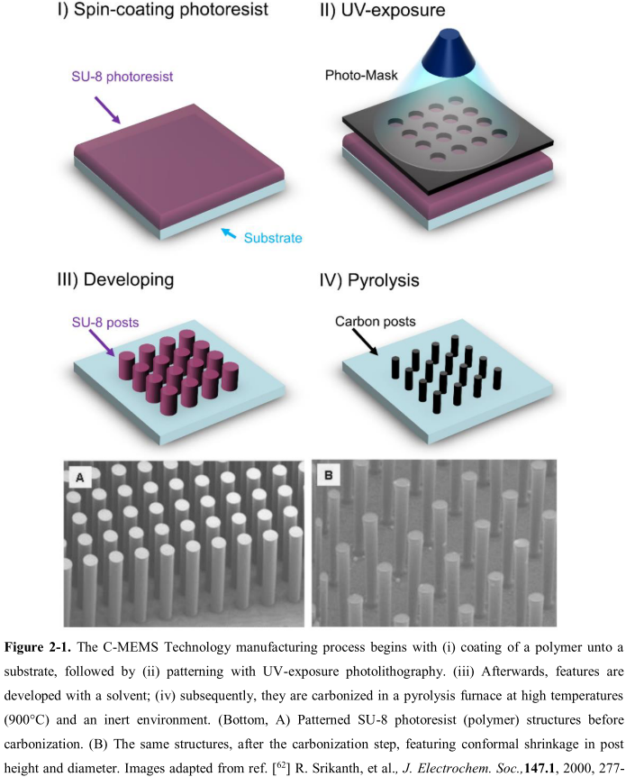
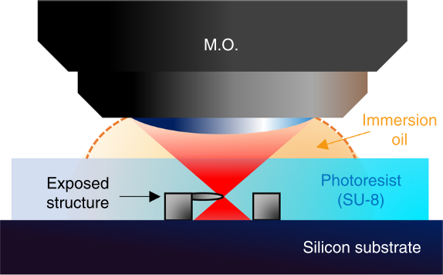
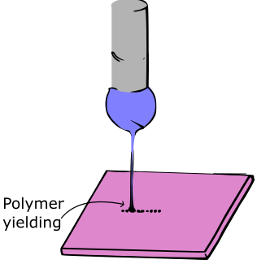
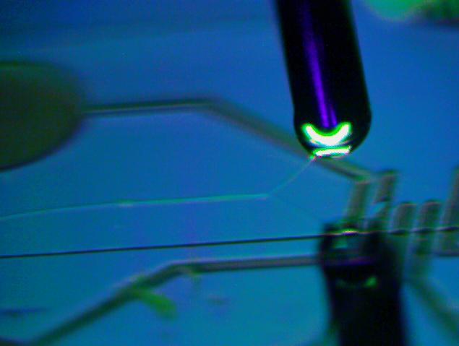
Current approaches
Photolithography
Physical & Optical Limitations
Two-Photon Polymerization (TPP)
Slow (mm per sec) & Expensive
*Near-Field Electrospinning (NFES)
Suspended Nanowires w/Spatial Control
V. Galstyan, M. Bhandari, V. Sberveglieri, G. Sberveglieri, E. Comini, Metal Oxide Nanostructures in Food Applications: Quality Control and Packaging, Chemosensors. 6 (2018) 16. https://doi.org/10.3390/chemosensors6020016.
D. Kluge, J.C. Singer, B.R. Neugirg, J.W. Neubauer, H.-W. Schmidt, A. Fery, Top–down meets bottom–up: A comparison of the mechanical properties of melt electrospun and self-assembled 1,3,5-benzenetrisamide fibers, Polymer (Guildf). 53 (2012) 5754–5759. https://doi.org/10.1016/j.polymer.2012.10.016.

Slide 11
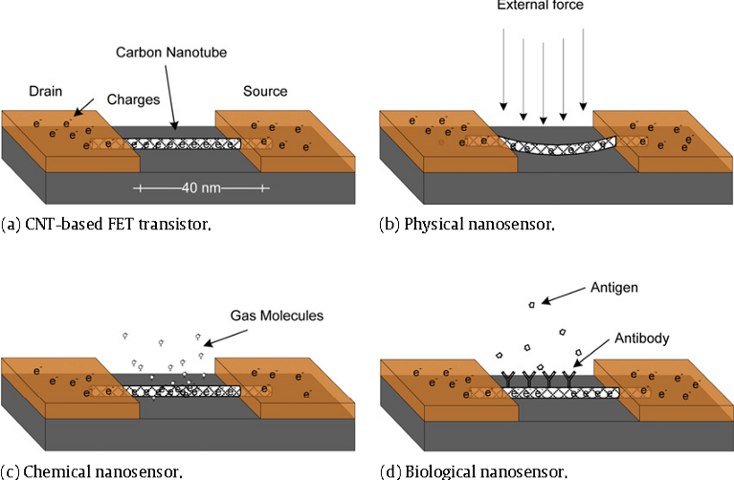
Glass-like Carbon NWs: Applications
V. Baudrit J, Recycling and Elimination of Wastes obtained from Agriculture by using Nanotechnology: Nanosensors, Int. J. Biosens. Bioelectron. 3 (2017) 368–375.https://doi.org/10.15406/ijbsbe.2017.03.00084.
R.L. McCreery, Advanced Carbon Electrode Materials for Molecular Electrochemistry, Chem. Rev. 108 (2008) 2646–2687. https://doi.org/10.1021/cr068076m.
G. Speranza, The Role of Functionalization in the Applications of Carbon Materials: An Overview, C — J. Carbon Res. 5 (2019) 84. https://doi.org/10.3390/c5040084.
Notes:
Remove general words (Applocations -> detection/sensors)
Problemas que solucionan estos sensores (contaminantes en agua, aire, temperatura en electrónicos, health care)

Slide 12
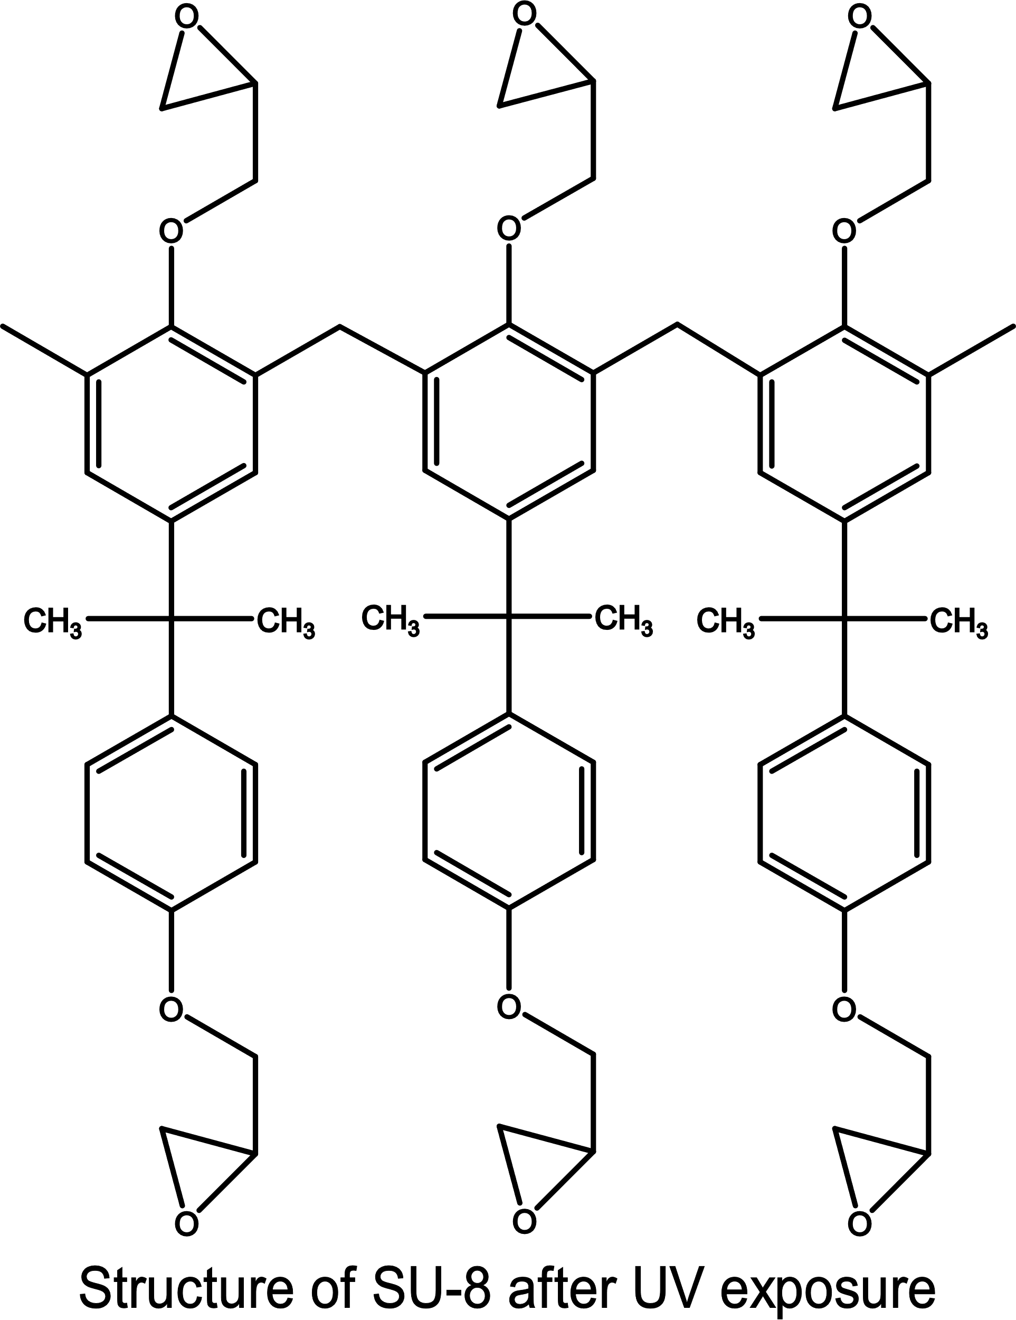
MicroChem’s SU-8
Pyrolysis of SU8 is currently the typical method to produce glass-like carbon.
Polymer patterning through photolithography
Carbonization through pyrolysis
However, photolithography generates waste in the spin-coating and developing steps. Also, it presents structural limitations.
Limitations can be overcome with other fabrication techniques, such as NFES
Microchem, Su-8 2000.5-2015, 2000.5, 2002, 2005, 2007, 2010, 2015. (2006) 1–5. papers3://publication/uuid/859F51B9-0382-4DE8-88A9-267F936939A3.

Slide 13
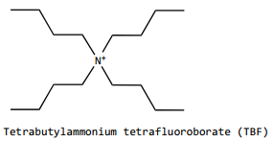
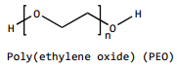
MicroChem’s SU-8
However, SU-8 as is not electrospinnable
SU-8 does not have the right viscosity & solution conductivity.
SU-8 is design for photolithography.
SU-8 + TBF + PEO
To increase the solution conductivity
To provided the required viscosity
… both needed for smooth PEO flow during electrospinning
D.R. Flores, Role of rheological properties in near field electrospun fibers morphology, (2017) 130.
B. Cárdenas Benítez, Advanced Manufacturing Techniques for the Fabrication and Surface Modification of Carbon Nanowires, Tecnológico de Monterrey, 2017.
Notes:
Remove background from figures
Para las aplicationes necesito que sea electrospinnalbe
Photolithography-able vs. Electrospinnableility
Highlight the PEO

Slide 14
NFES Process Parameters
Properties of an electrospun fiber depend on many parameters,
and each parameter also depends on the polymer-solvent system.
Solution Parameters:
Concentration
Molecular weight
Viscosity
Electrical conductivity
Ambient Parameters:
Humidity
Temperature
Process Parameters:
Applied Voltage
Flow rate
Working distance
The interdependence between the process and solution parameters presents a challenge to predict the fiber morphology.
S.B. Gadkari, Scaling analysis for electrospinning, Springerplus. 3 (2014) 705. https://doi.org/10.1186/2193-1801-3-705.
Notes:
Predicción de diámetro y control espacial
Mention my important parameters: conductivity low diameter spatial control
Challenge de control de diametro

Slide 15
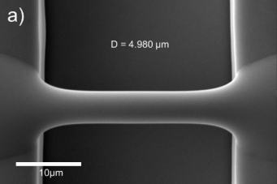
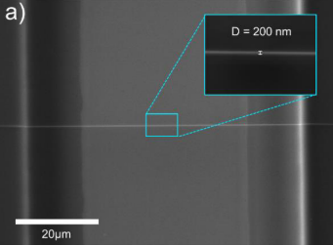
Best Results so far by NFES (previous work)
Fiber yield rate of 81 %
Fiber diameter before pyrolysis of 4.966 μm
Fiber diameter after pyrolysis of 204 nm
Fiber length of 60.5 ± 4.3 μm
Fiber resistance from 407 KΩ to 1.727 MΩ
wt% PEO 0.25 | SU-8 2002 [mg] | PEO [mg] | TBF [mg]
 | 2246 | 5.65 | 11.32
D.R. Flores, Role of rheological properties in near field electrospun fibers morphology, (2017) 130.
B. Cárdenas Benítez, Advanced Manufacturing Techniques for the Fabrication and Surface Modification of Carbon Nanowires, Tecnológico de Monterrey, 2017.

Slide 16
Methods: Implications of PEO
The fiber yield rate and fiber conductivity are impacted negatively as PEO introduces more oxygen to the solution
Some samples are destroyed during pyrolysis
High variance in the obtained conductivity across samples.
The addition of oxygen decreases the char yield.
D.R. Flores, Role of rheological properties in near field electrospun fibers morphology, (2017) 130.
B. Cárdenas Benítez, Advanced Manufacturing Techniques for the Fabrication and Surface Modification of Carbon Nanowires, Tecnológico de Monterrey, 2017.
Notes:
Diagram – PEO pyrolysis
Mention the rol of Oxygen – abd connect it witht the desired characteristics – closed porous
Pyrolysis stages
Balance of properties

Slide 17
Objectives

Slide 18
Objectives
General. Study the feasibility of oxygen-less polymers in NFES processes for the fabrication of glass-like carbon nanowires.
Specific1. Replace the SU-8 photoresist with a new polymer solution that can be electrospun by NFES, photopolymerized, and then pyrolyzed.
Specific2. Determine if polymer solutions can be easily employed for
conducting carbon nano-wire production through rheological analyses to allow the NFES process.
Specific3. Discover a similar PEO-SU8-TBF material that input favourable properties to the carbon nanowire yield, by replacing PEO in the system.

Slide 19
NFES literature review
Specific1. Replace the SU-8 photoresist with a new polymer solution that can be electrospun by NFES, photopolymerized, and then pyrolyzed.
Notes:
To find substitutions to keep
Spatial control, high conductivity, low diameter
Find new formulations or replace PEO in SU8 -> find new materials

Slide 20
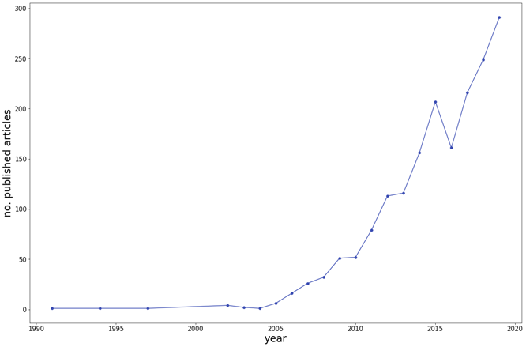
Methods: NFES literature (first NFES apparatus built in 2003 by J. Kameoka et al.)
Thinnest fiber achieved by C. Chang et al. with ~50 nm in diameter. (PEO in water)
However, fiber yield rate was not reported
J. Kameoka, R. Orth, Y. Yang, D. Czaplewski, R. Mathers, G.W. Coates, H.G. Craighead, A scanning tip electrospinning source for deposition of oriented nanofibres, Nanotechnology. 14 (2003) 1124–1129. https://doi.org/10.1088/0957-4484/14/10/310.
C. Chang, K. Limkrailassiri, L. Lin, Continuous near-field electrospinning for large area deposition of orderly nanofiber patterns, Appl Phys Lett. (2008) 3. https://doi.org/10.1063/1.2975834.

Slide 21

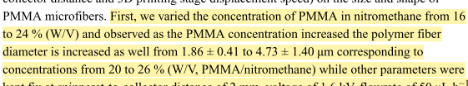
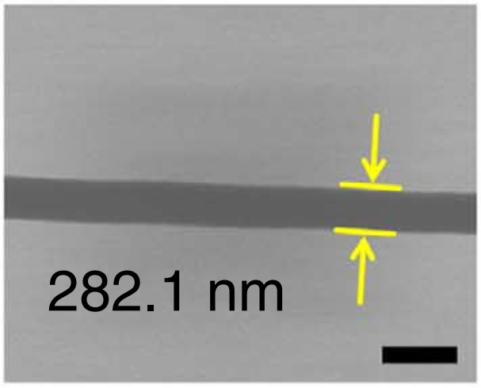
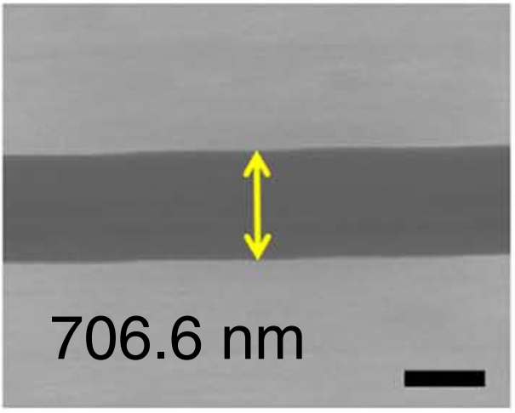
Methods: Data collection (analysis of NFES articles from 2003 to 2020)
The author mentions the process parameters and fiber properties within the article in writing.
Fattahi2017
Figures from Min2013
S.-Y. Min, T.-S. Kim, B.J. Kim, H. Cho, Y.-Y. Noh, H. Yang, J.H. Cho, T.-W. Lee, Large-scale organic nanowire lithography and electronics, Nat. Commun. 4 (2013) 1773. https://doi.org/10.1038/ncomms2785.
P. Fattahi, J.T. Dover, J.L. Brown, 3D Near-Field Electrospinning of Biomaterial Microfibers with Potential for Blended Microfiber-Cell-Loaded Gel Composite Structures, Adv. Healthc. Mater. 6 (2017) 1700456. https://doi.org/10.1002/adhm.201700456.

Slide 22
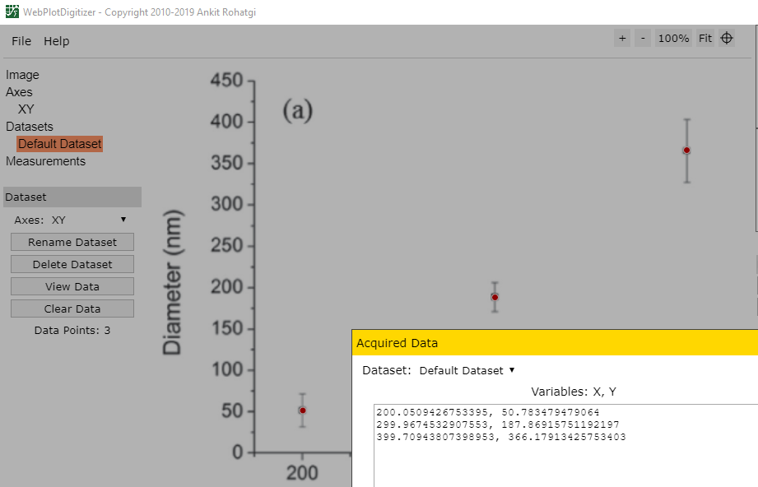
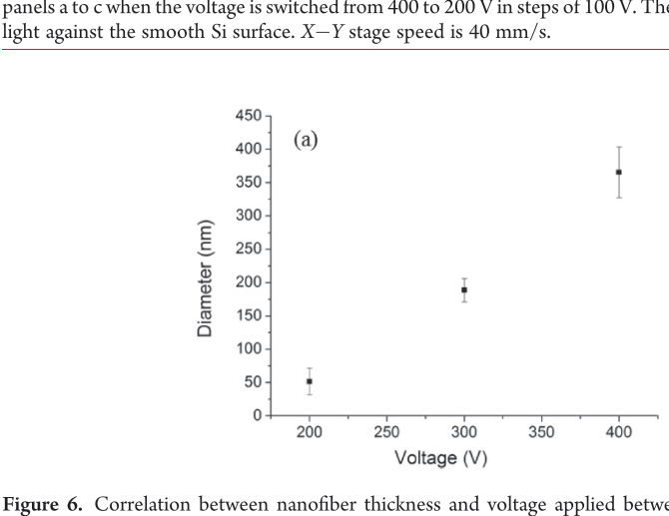
Methods: Data collection (analysis of NFES articles from 2003 to 2020)
The author provides the data in plots and graphs.
WebPlotDigitalizer (https://github.com/ankitrohatgi/WebPlotDigitizer):
M.J. Madou, D. Dunn-Rankin, L. Kulinsky, A. Mirsepassi, G.S. Bisht, S. Oh, G. Canton, Controlled Continuous Patterning of Polymeric Nanofibers on Three-Dimensional Substrates Using Low-Voltage Near-Field Electrospinning, Nano Lett. 11 (2011) 1831–1837. https://doi.org/10.1021/nl2006164.
Applied voltage vs. fiber diameter by Madou2011

Slide 23
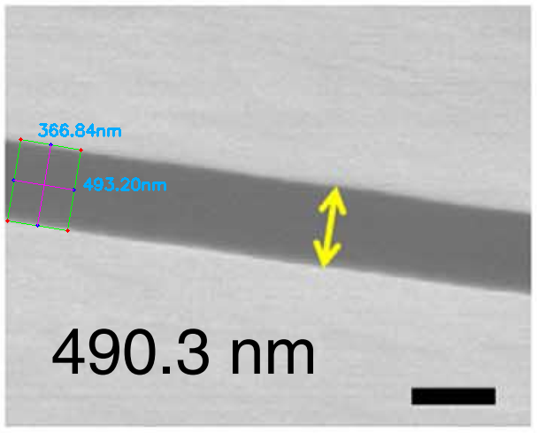
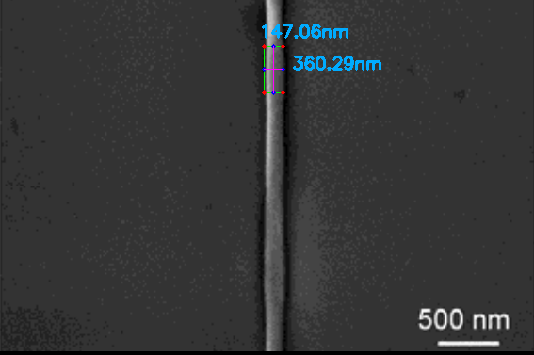
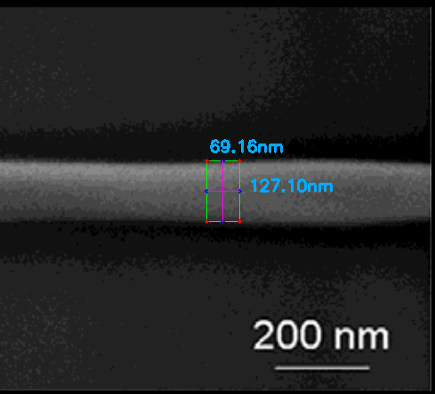
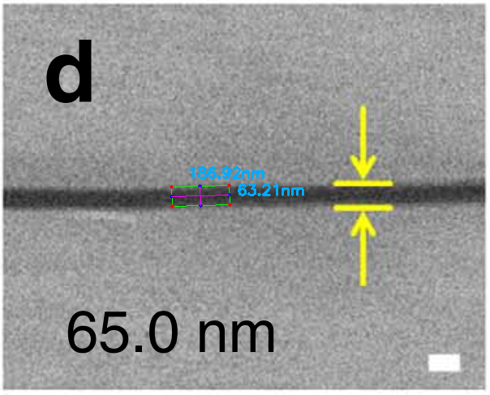
Methods: Data collection (analysis of NFES articles from 2003 to 2020)
The author does not mention the fiber diameter in writing but provides a EM characterization.
Python Image Analysis (with a 3.2% error in avg.):
Figures from Min2013
Figures from Camillo2013
S.-Y. Min, T.-S. Kim, B.J. Kim, H. Cho, Y.-Y. Noh, H. Yang, J.H. Cho, T.-W. Lee, Large-scale organic nanowire lithography and electronics, Nat. Commun. 4 (2013) 1773. https://doi.org/10.1038/ncomms2785..
https://github.com/katagirimx/OpenCV-image-measuring
D. Di Camillo, V. Fasano, F. Ruggieri, S. Santucci, L. Lozzi, A. Camposeo, D. Pisignano, Near-field electrospinning of conjugated polymer light-emitting nanofibers, Nanoscale. 5 (2013) 11637–11642. https://doi.org/10.1039/C3NR03094F.

Slide 24
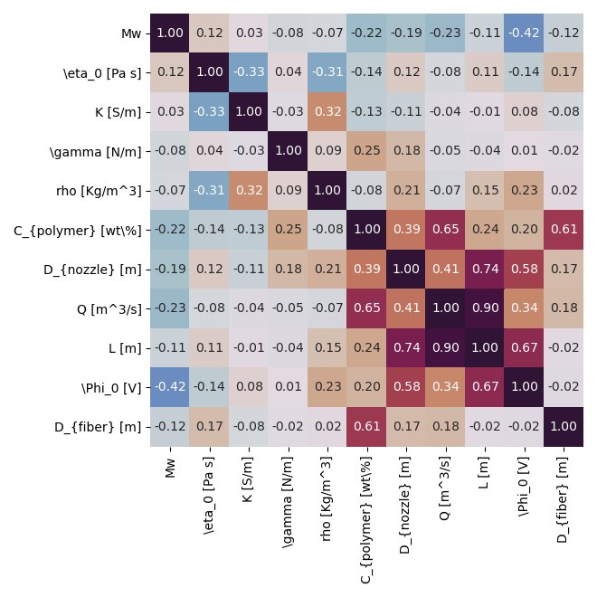
Conclusion 1.1:
Polymer Concentration,
Nozzle Diameter,
&
Solution Deposition Rate,
are the main drivers of the final Fiber Diameter

Slide 25
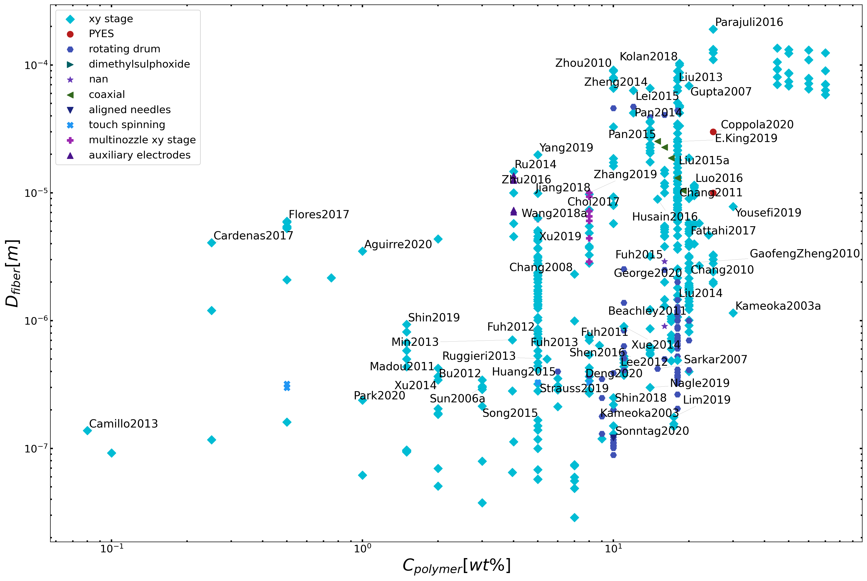
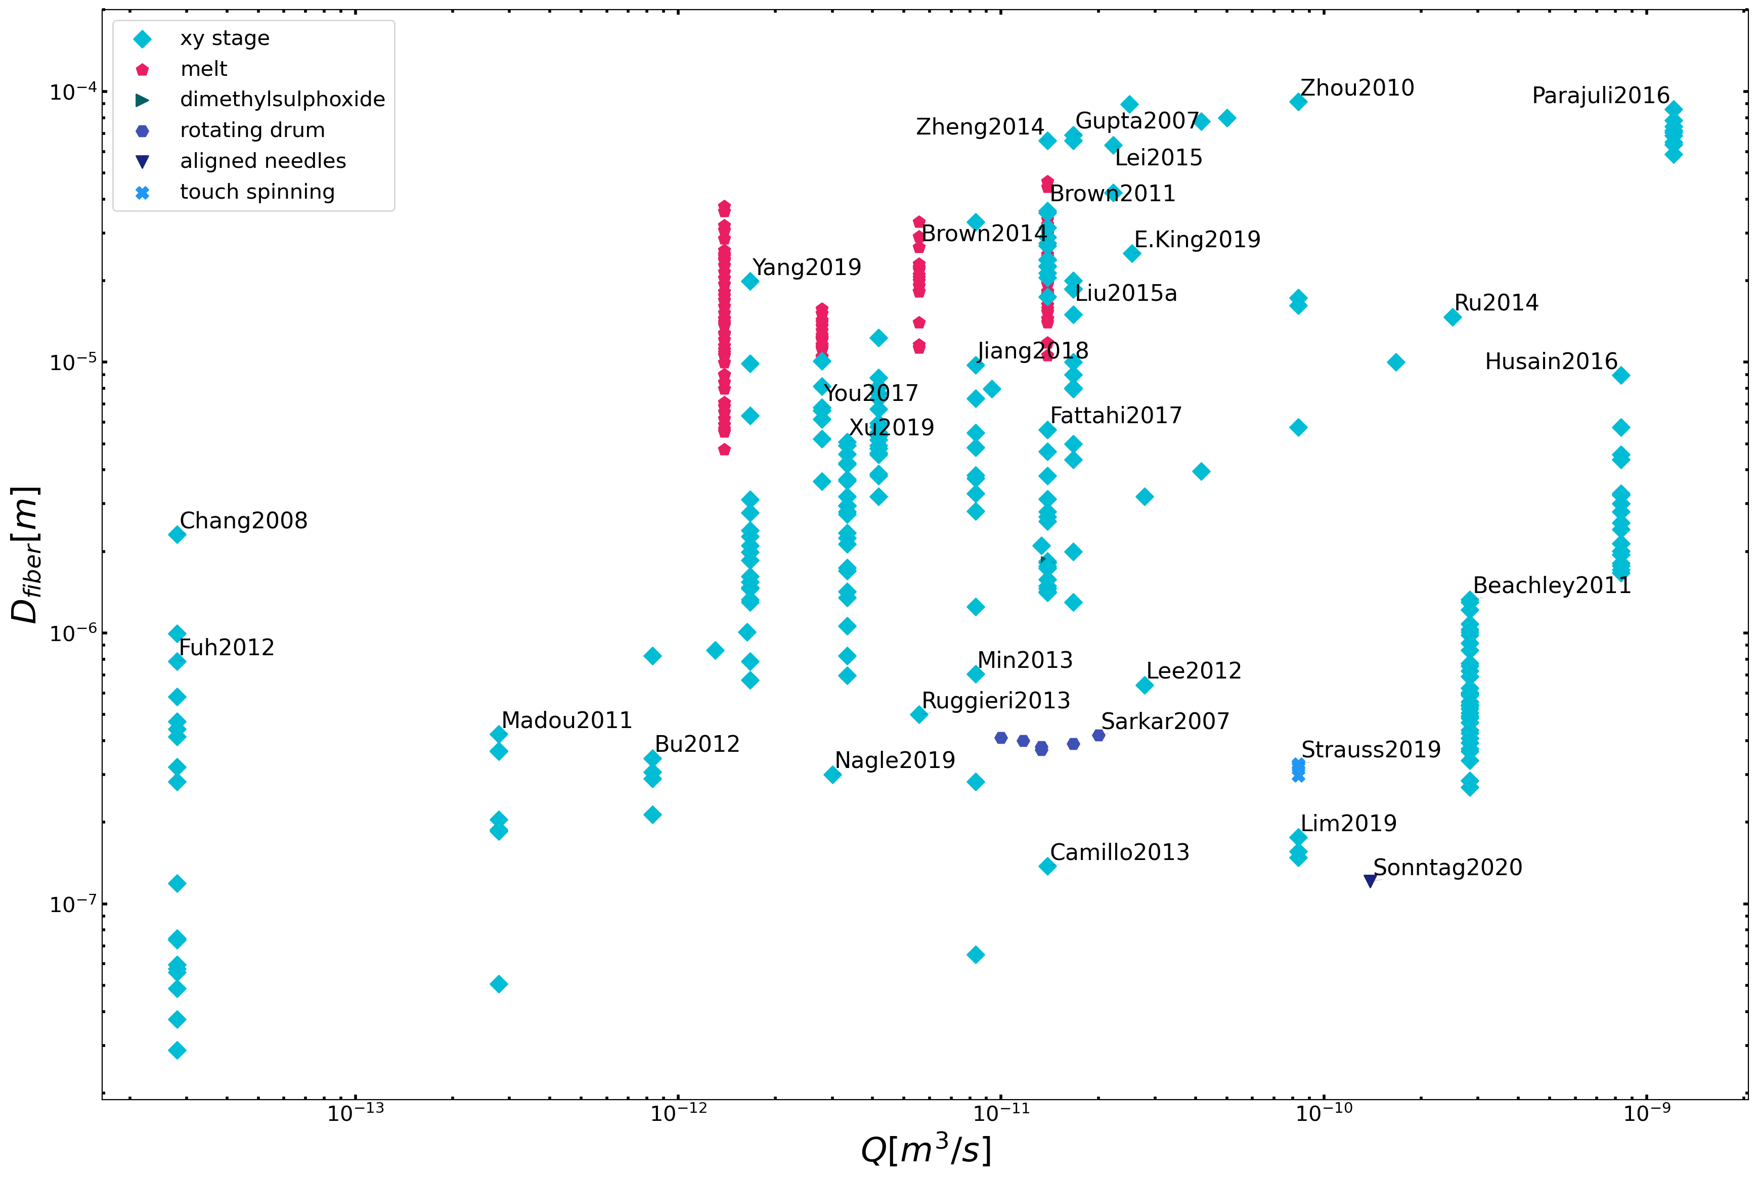
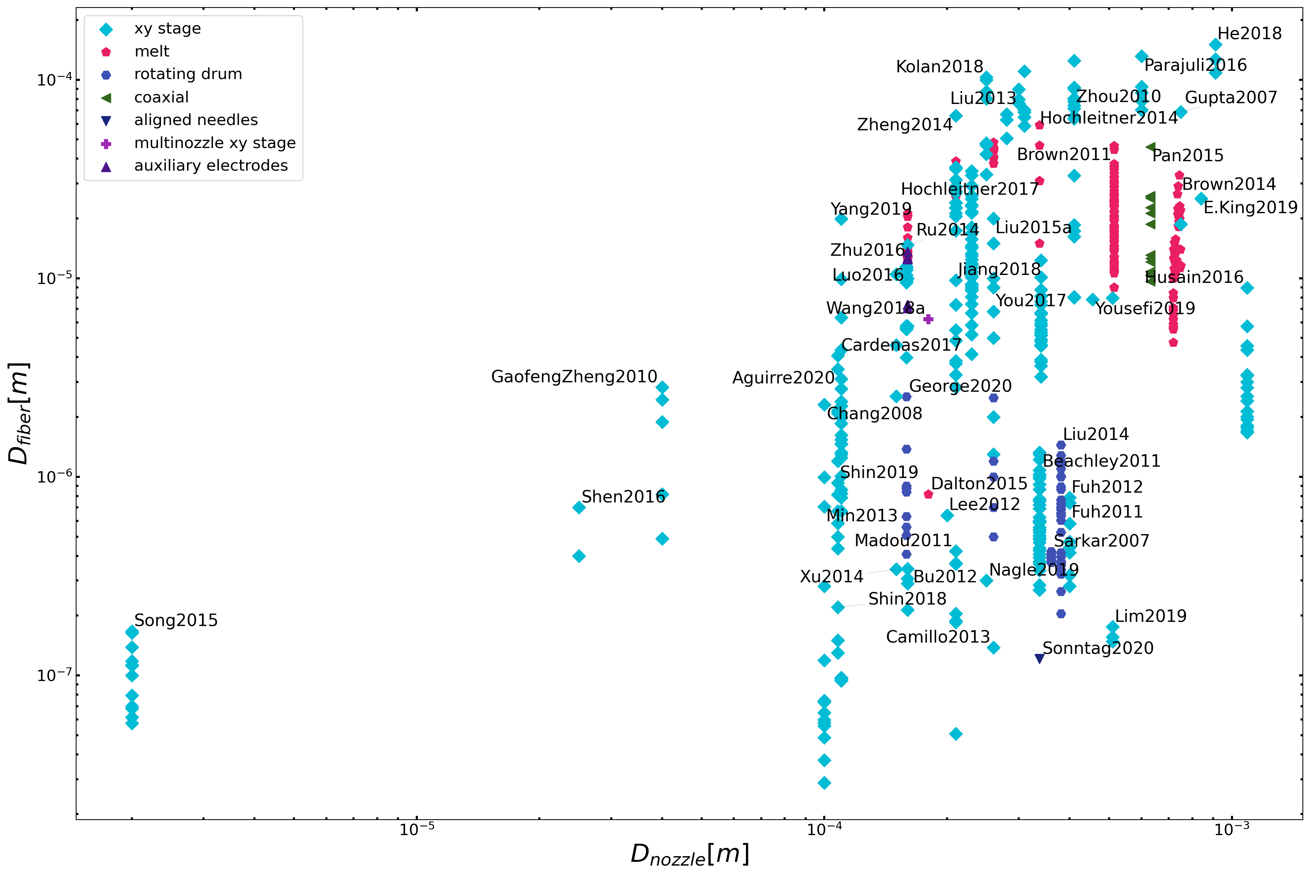
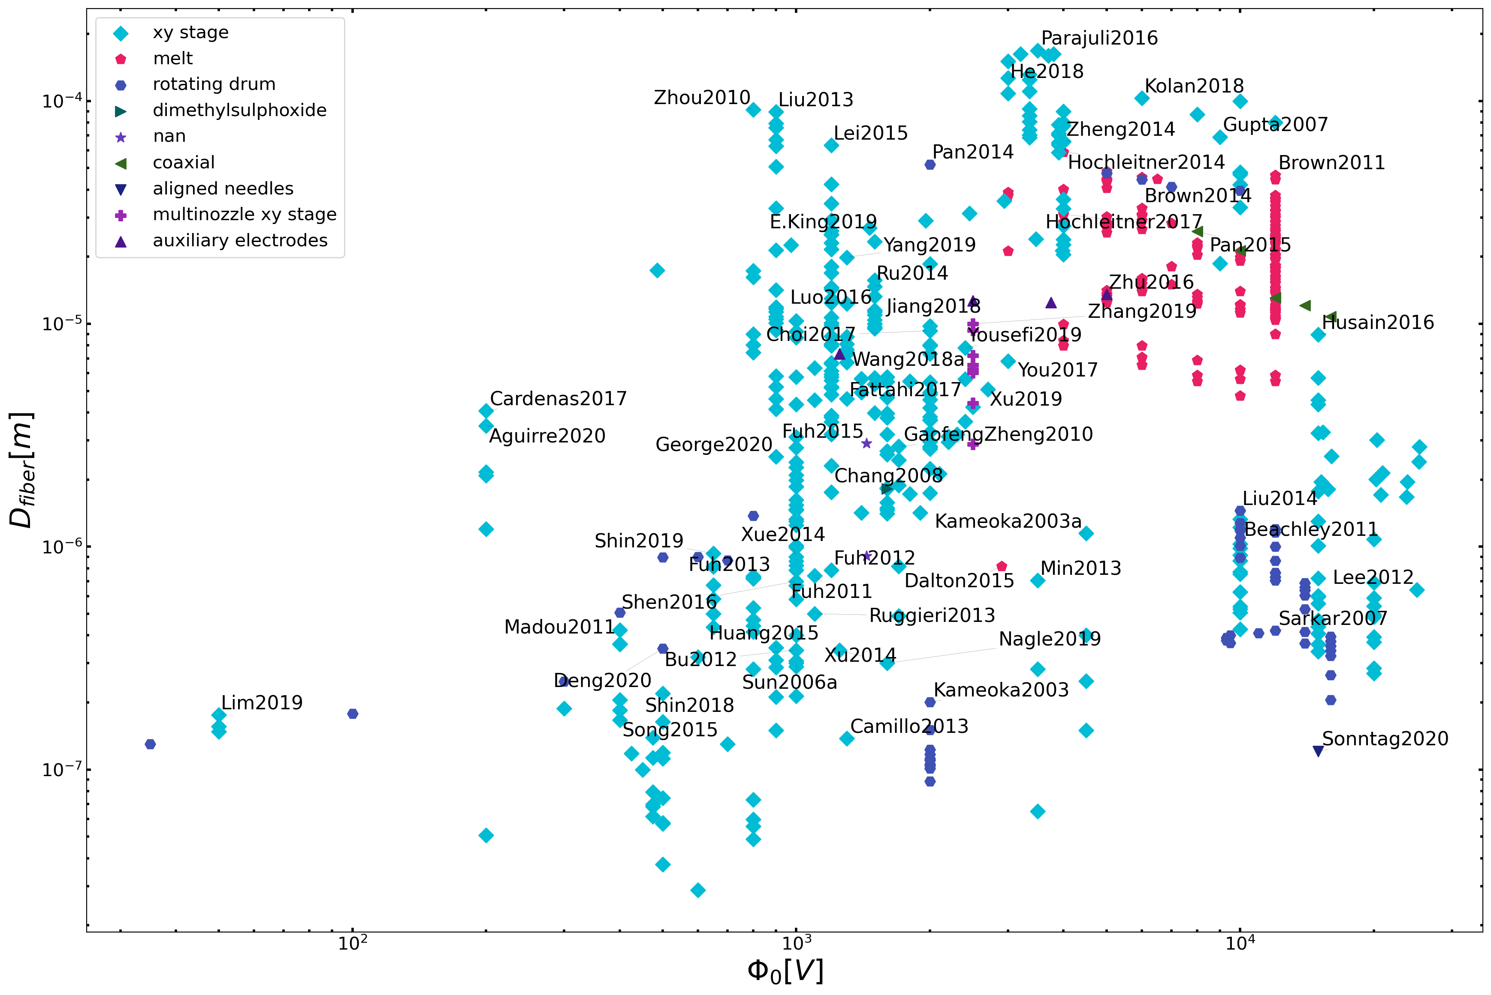
low polymer
concentrations
slow solution flow rates
Conclusion 1.1:
Process Parameters
small needle
diameters
low voltages
25

Slide 26
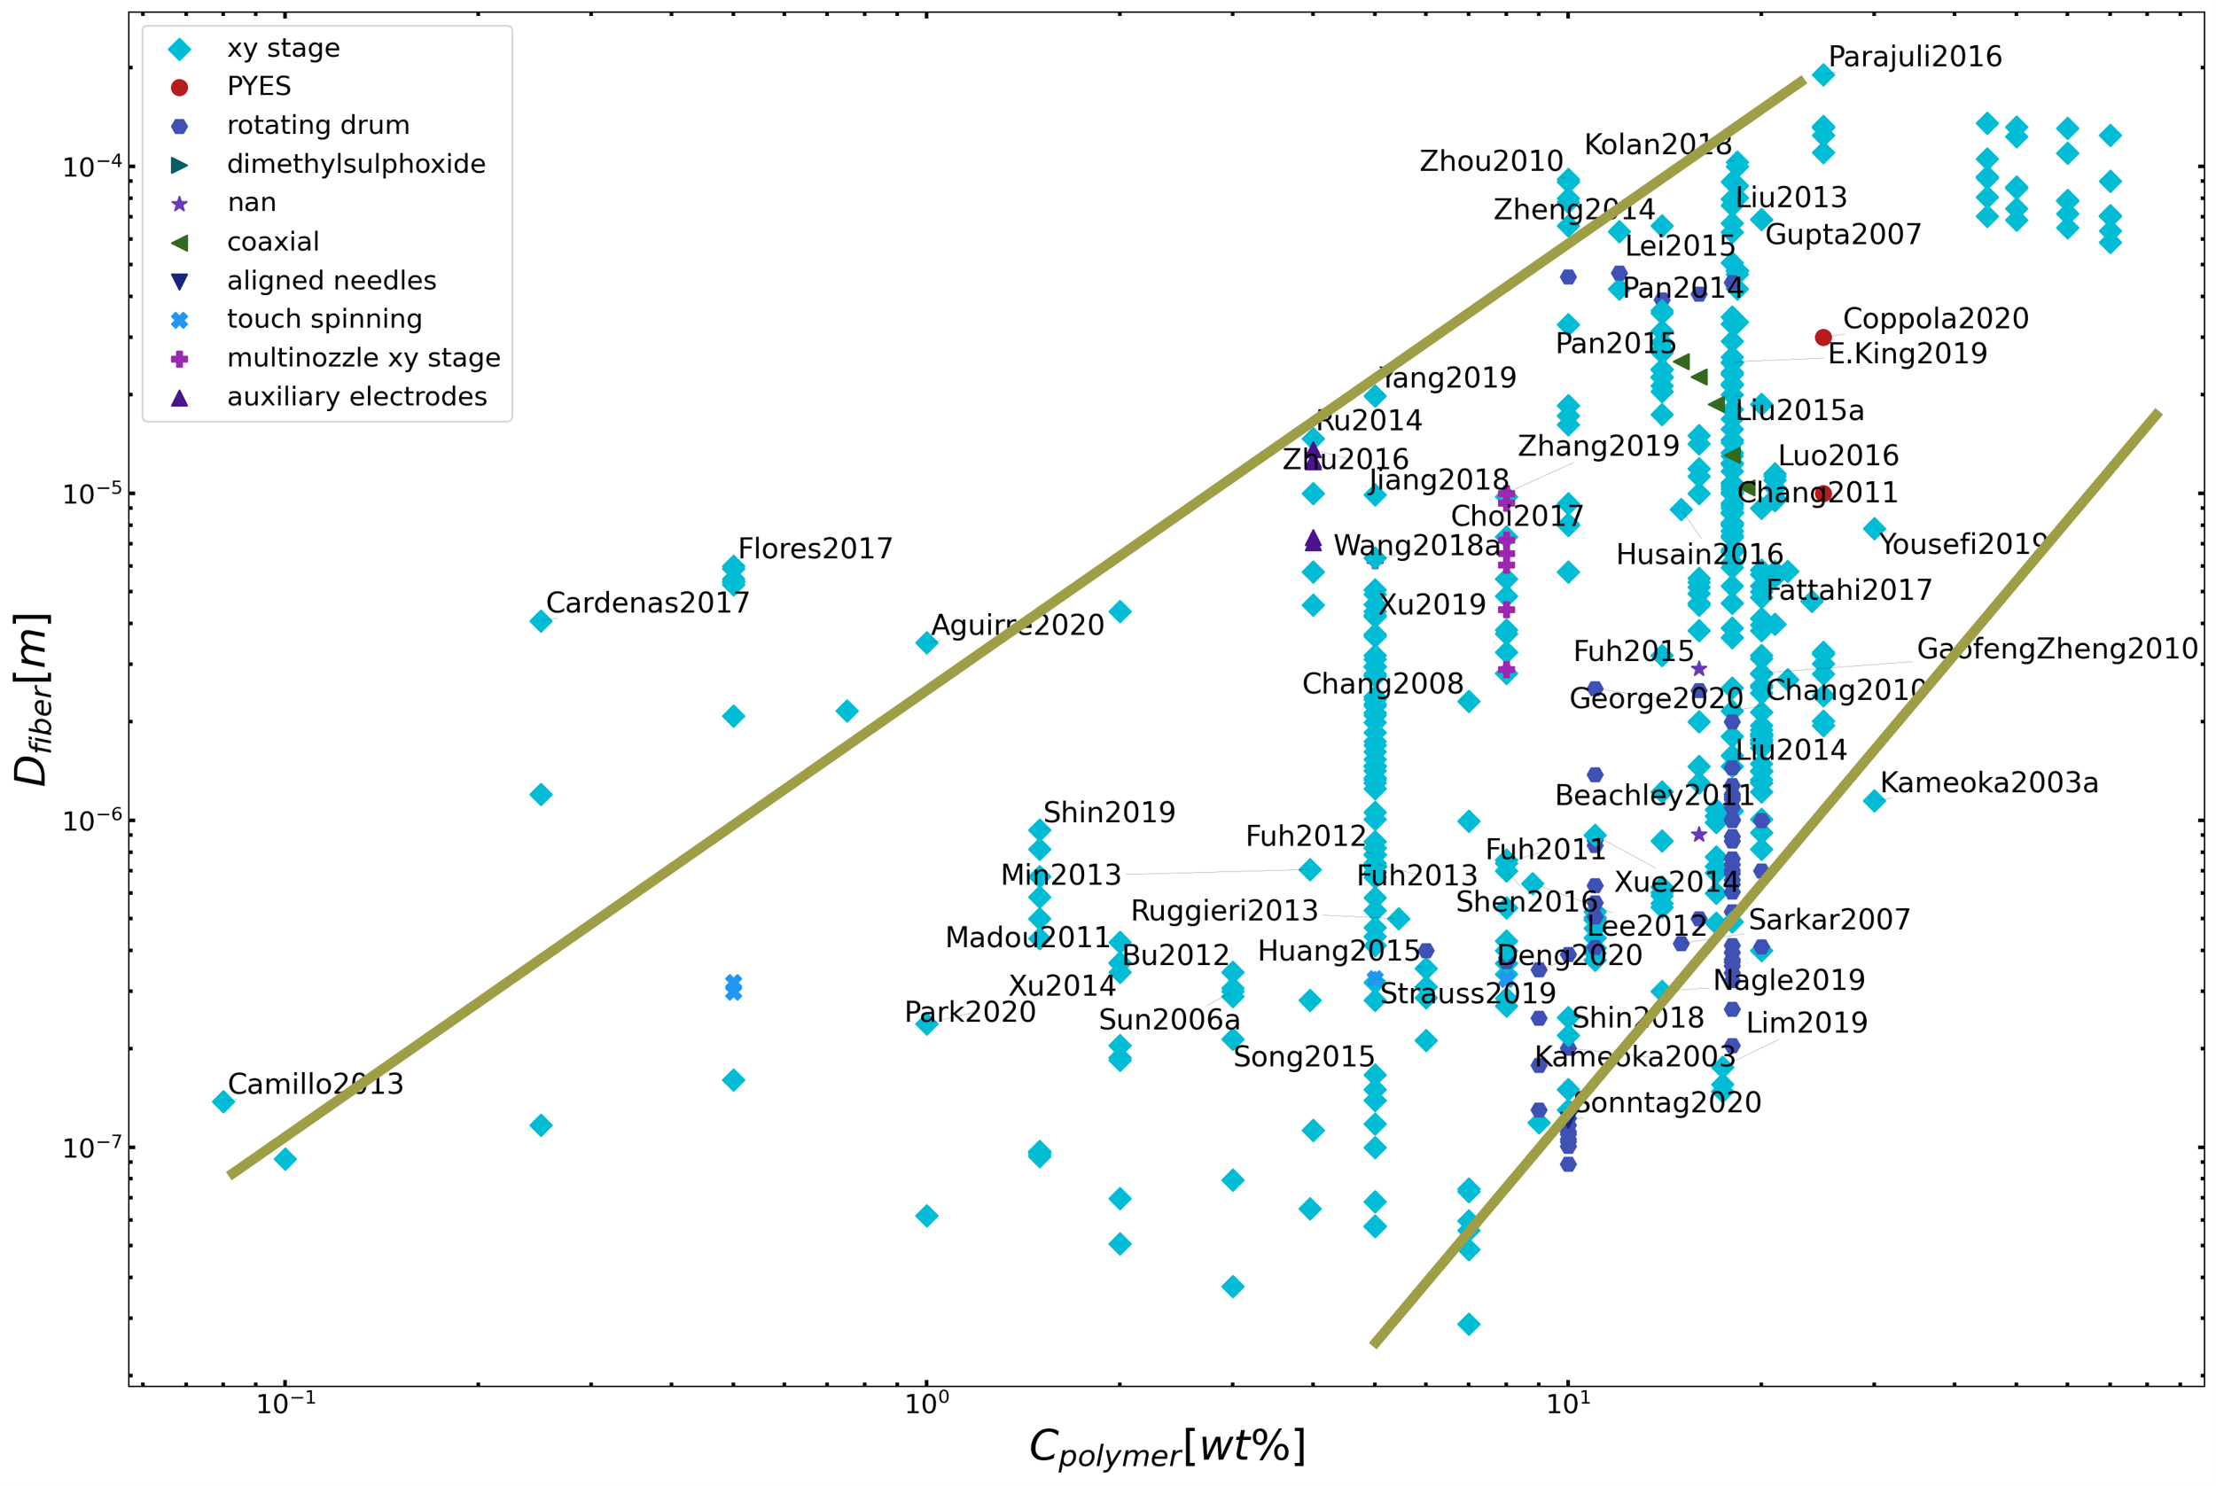
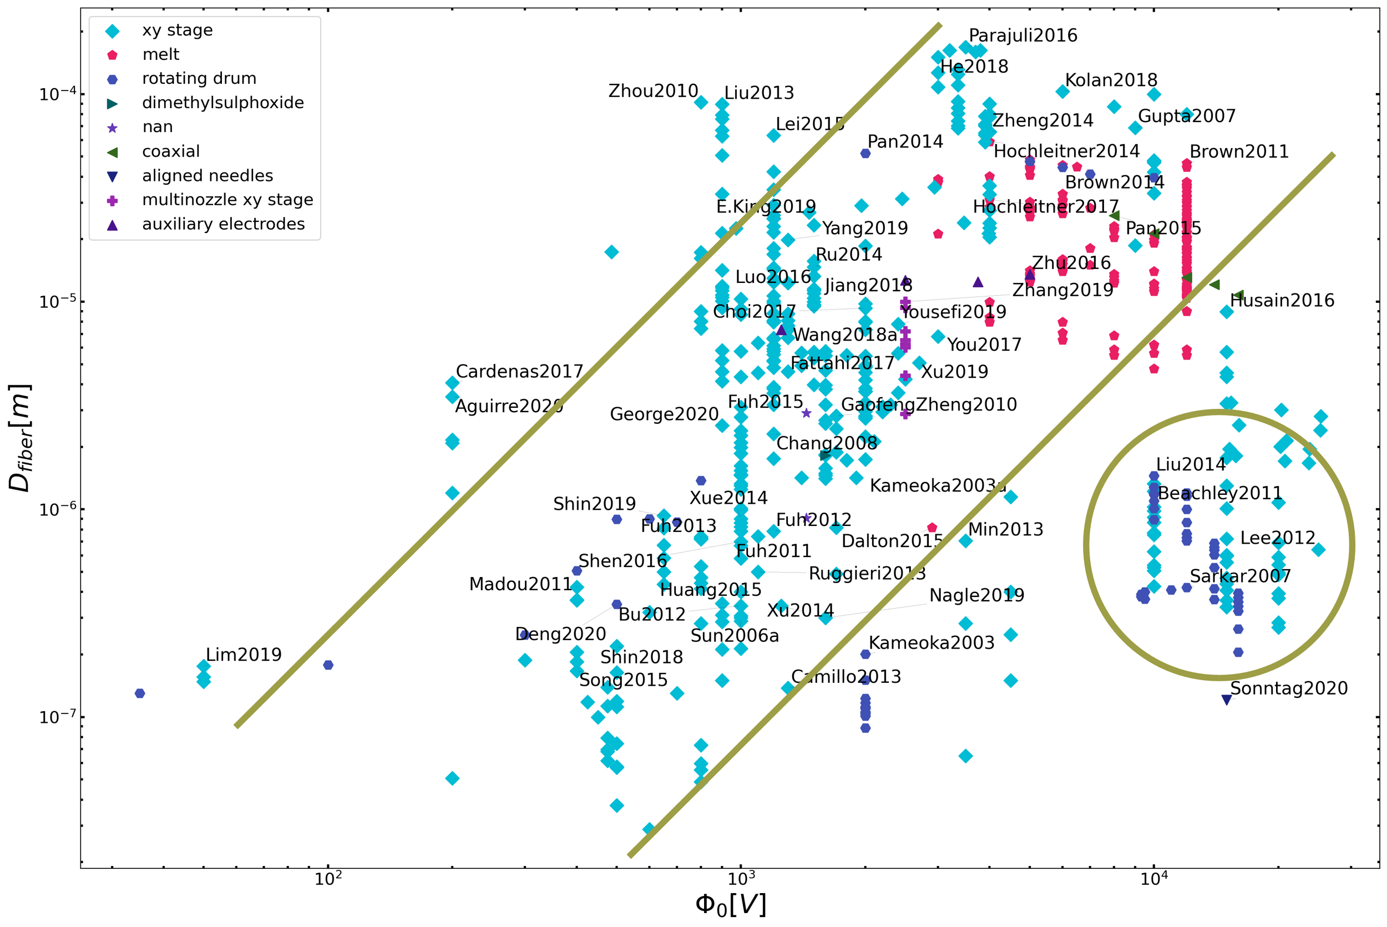
Conclusion 1.2: Let’s focus on polymer concentration
Polymer concentration is the most reliable process parameter to control the morphology of electrospun fibers. (regardless the type of NFES process)

Slide 27
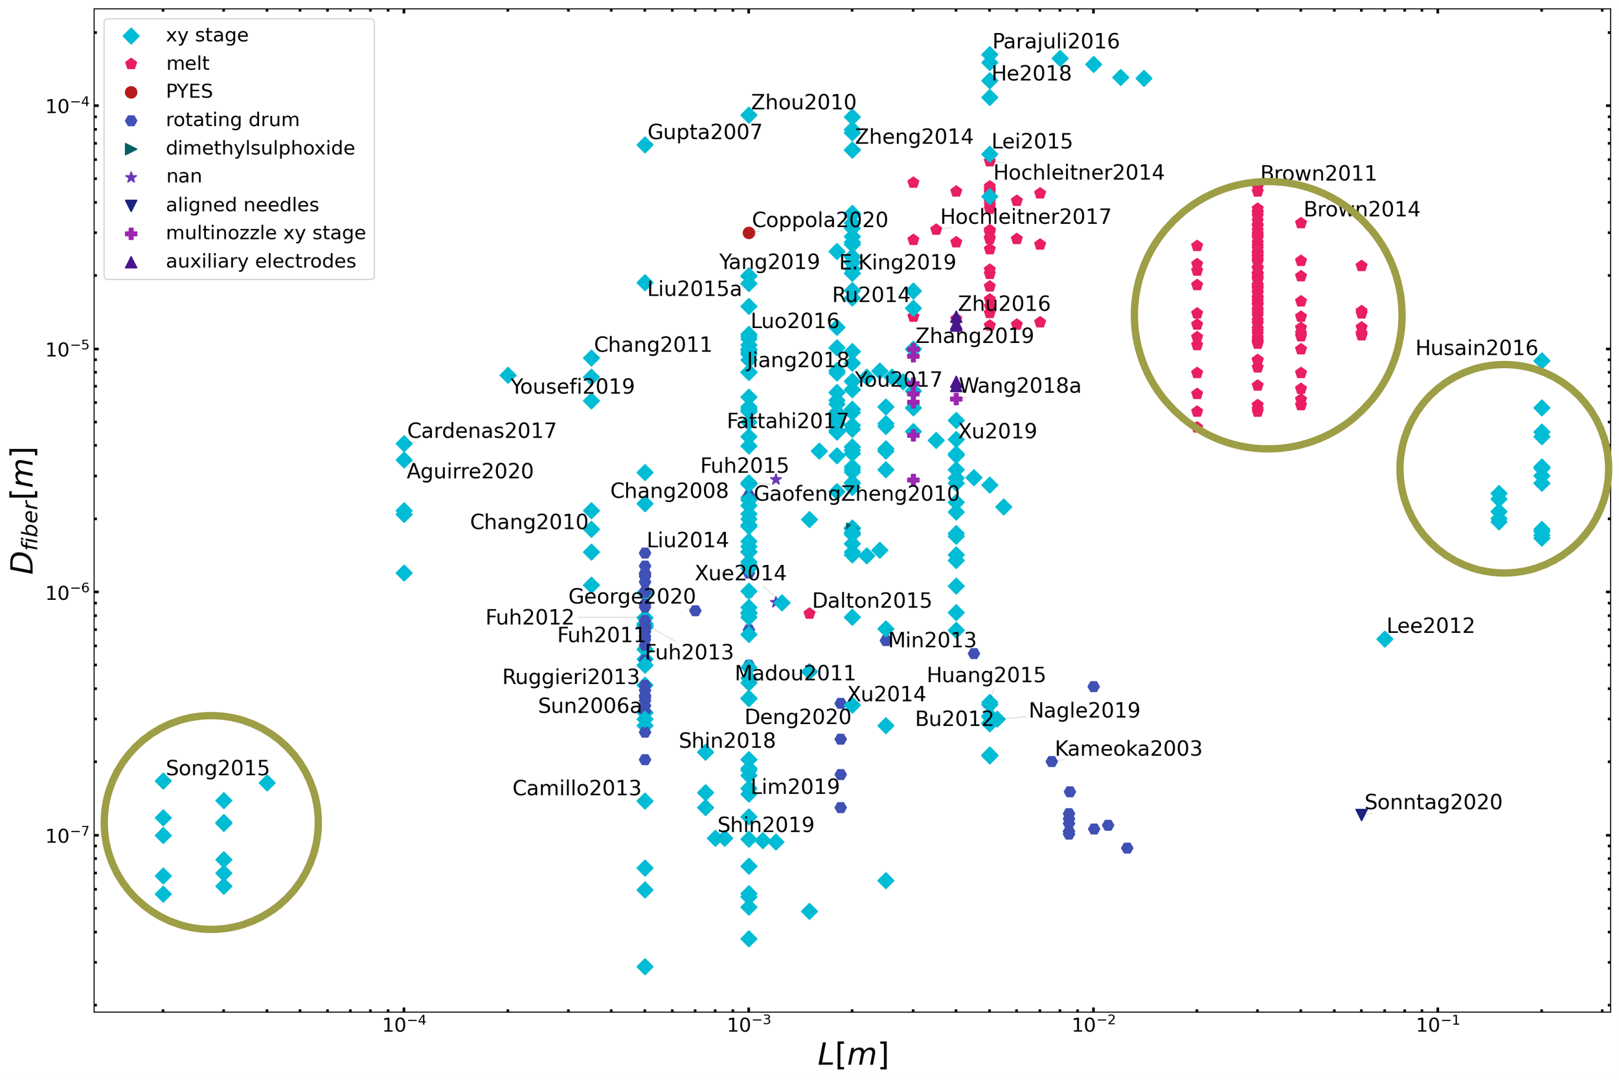
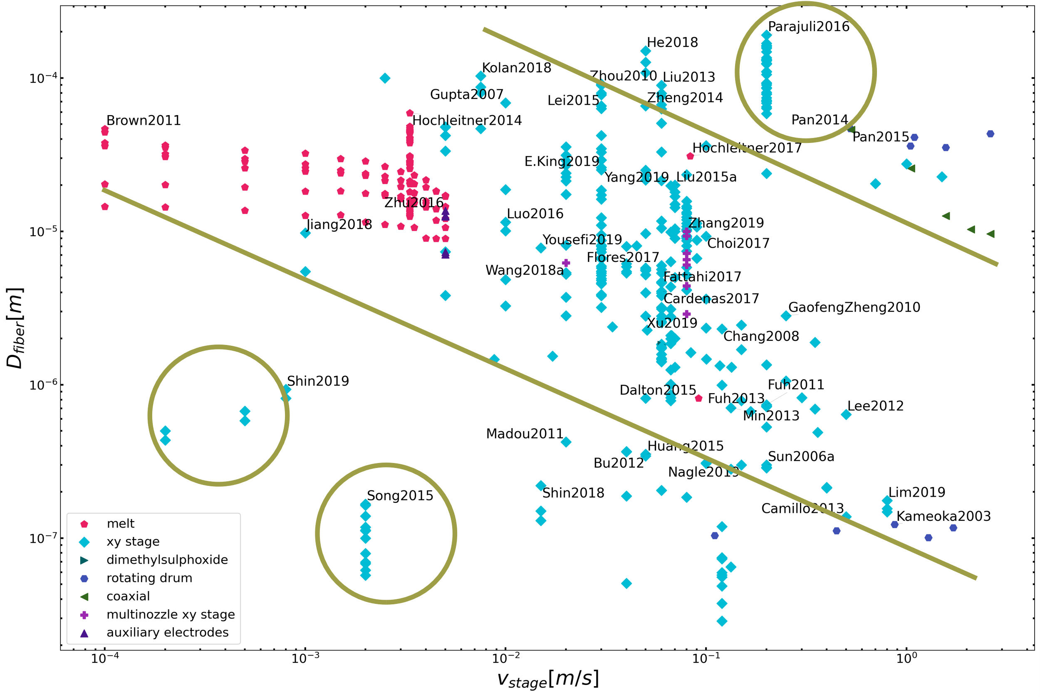
Conclusion 1.2: Let’s focus on polymer concentration
Polymer concentration is the most reliable process parameter to control the morphology of electrospun fibers. (regardless the type of NFES process)
Notes:
Song2015 : glass capillary tip
Brown201X : melt ES
Husain2016 : L = cm
Shin2019 : coiled/meander fibers
Parajuli2016 : concentrations 25 – 80%

Slide 28
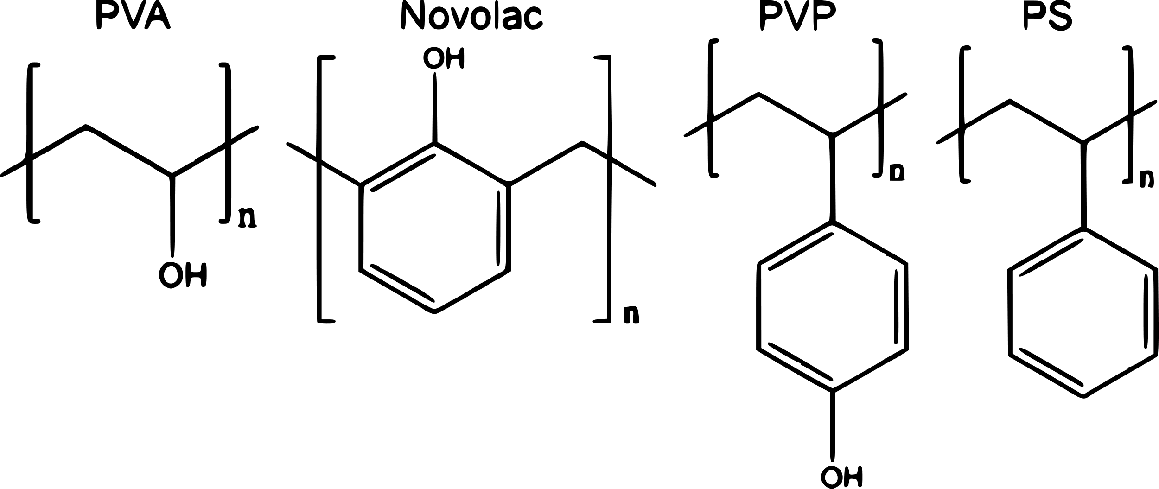
Conclusion1.3: Selection of Polymer-Solvent combinations
Zhenan Bao et al. investigated the effect of the polymer chemical
Structure of:
higher sp2 carbon content translates into higher graphitization degree and higher electrical conductivity
polymers with functional groups are required for the creation of smooth and continuous fibers.
N. Liu, K. Kim, H.Y. Jeong, P.C. Hsu, Y. Cui, Z. Bao, Effect of Chemical Structure on Polymer-Templated Growth of Graphitic Nanoribbons, ACS Nano. 9 (2015) 9043–9049. https://doi.org/10.1021/acsnano.5b03134.
Notes:
Bao lit review
Mention templating effect & pipeline stacking
PVP and Novolac have one benzene ring in each repeating unit,
PVA is mainly made out of sp3 carbon
PS is not functionalized

Slide 29
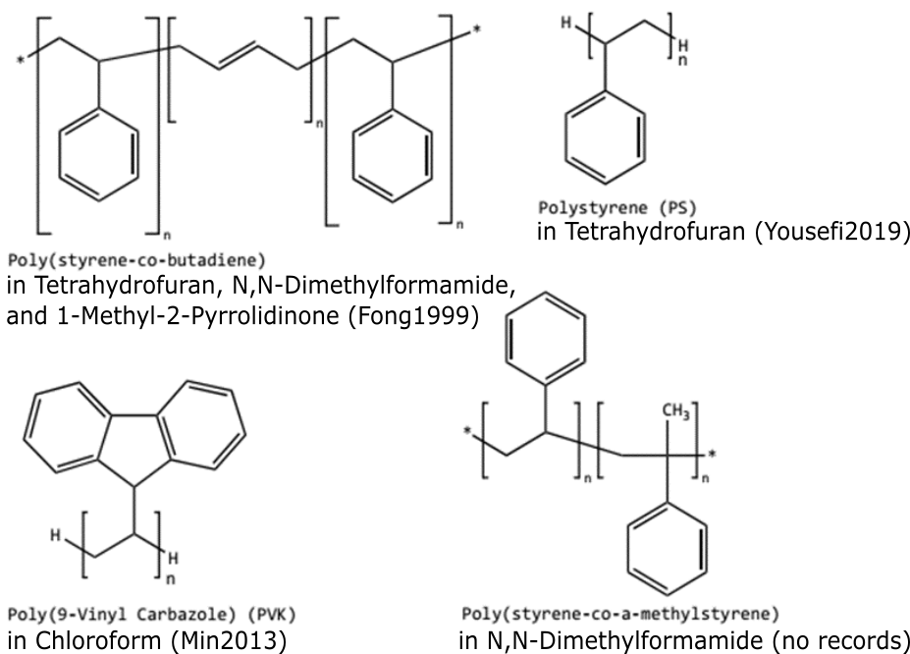
Conclusion1.3: Selection of Polymer-Solvent combinations
Polymers with high carbon content relative to oxygen content
A.A. Yousefi, A.R. Mohebbi, S. Falahdoost Moghadam, S.A. Poursamar, L. Hao, Uniaxially aligned microwire networks for flexible transparent electrodes using a novel electrospinning set-up, Sol. Energy. 188 (2019) 1111–1117. ttps://doi.org/10.1016/j.solener.2019.07.007.
H. Fong, D.H. Reneker, Elastomeric nanofibers of styrene-butadiene-styrene triblock copolymer, J. Polym. Sci. Part B Polym. Phys. 37 (1999) 3488–3493. https://doi.org/10.1002/(SICI)1099-0488(19991215)37:24<3488::AID-POLB9>3.0.CO;2-M.
S.-Y. Min, T.-S. Kim, B.J. Kim, H. Cho, Y.-Y. Noh, H. Yang, J.H. Cho, T.-W. Lee, Large-scale organic nanowire lithography and electronics, Nat. Commun. 4 (2013) 1773. https://doi.org/10.1038/ncomms2785.
Notes:
Mw
Aromaticidad
Cantidad de carbono
Ratio oxygen / carbon in pyrolysis

Slide 30
Rheology Analyses
Specific2. Determine if polymer solutions can be easily employed for conducting carbon nano-wire production through rheological analyses to allow the NFES process.

Slide 31
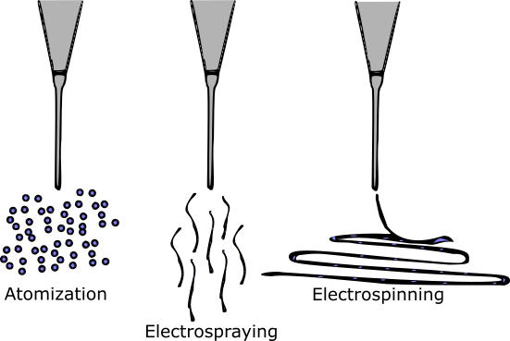
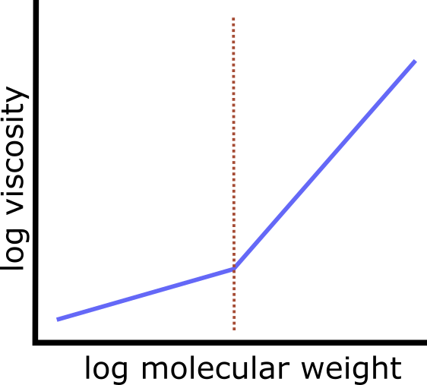
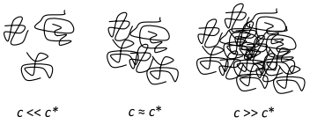
Literature claims
Under some critical concentration NFES yields beads or small fibres
Viscosity increases with molecular weight
Over some critical concentration NFES continuous fibres
The general belief is that the molecular weight needs to be sufficient enough to create or induce entanglements
D.R. Flores, Role of rheological properties in near field electrospun fibers morphology, (2017) 130.
G.L. Wilkes, An overview of the basic rheological behavior of polymer fluids with an emphasis on polymer melts, J. Chem. Educ. 58 (1981) 880. https://doi.org/10.1021/ed058p880.

Slide 32
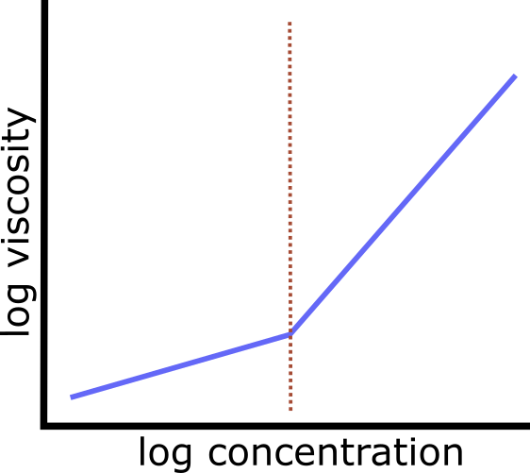
Literature claims
As “electropinnability” is determined by the polymer chain entanglement,
chain entanglement is controlled by molecular weight,
increasing molecular weight increases viscosity, and
viscosity is controlled by polymer concentration, then
The critical/spinnable concentration can be found in a viscosity vs. concentration plot
critical
concentration
D.R. Flores, Role of rheological properties in near field electrospun fibers morphology, (2017) 130.
G.L. Wilkes, An overview of the basic rheological behavior of polymer fluids with an emphasis on polymer melts, J. Chem. Educ. 58 (1981) 880. https://doi.org/10.1021/ed058p880.

Slide 33
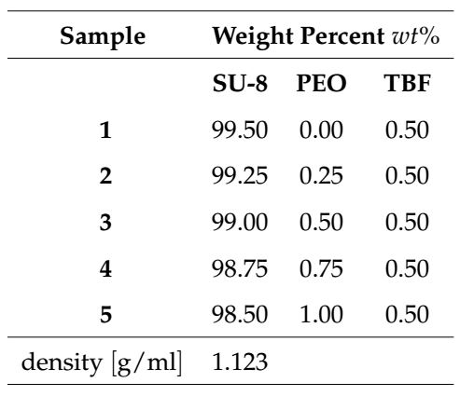
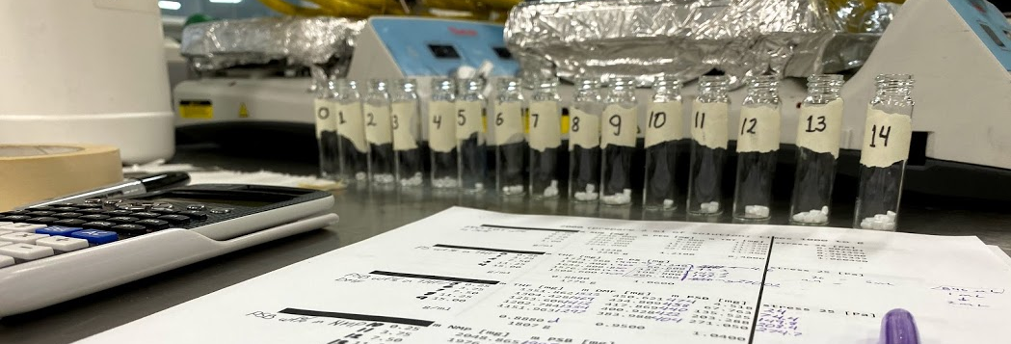
Methods: Sample Preparation (SU8-PEO)
3.0 ml samples
on a heating plate at 160 rpm and 60°C, for 2 hours each

Slide 34
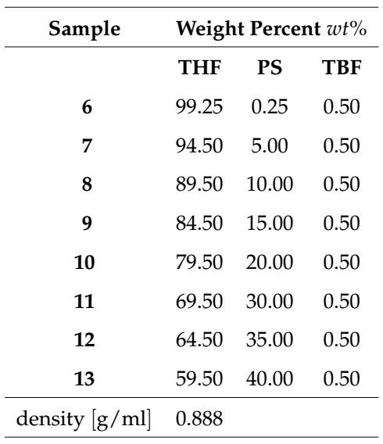
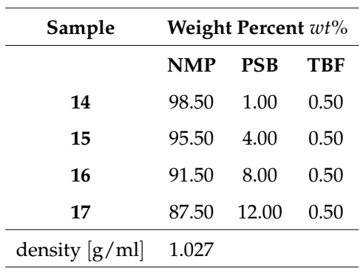
Methods: Sample Preparation (PS & PSB)

Slide 35
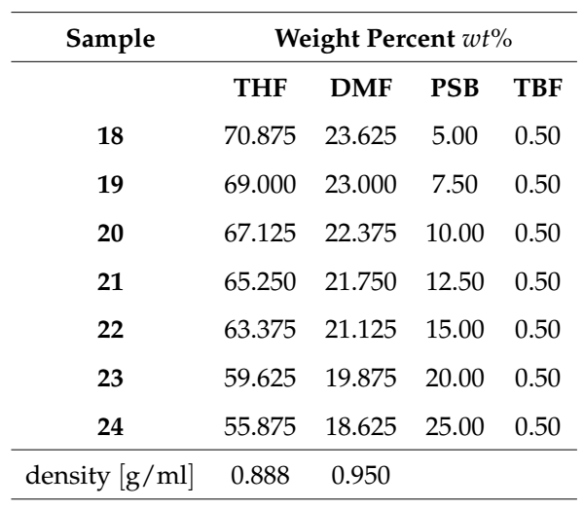
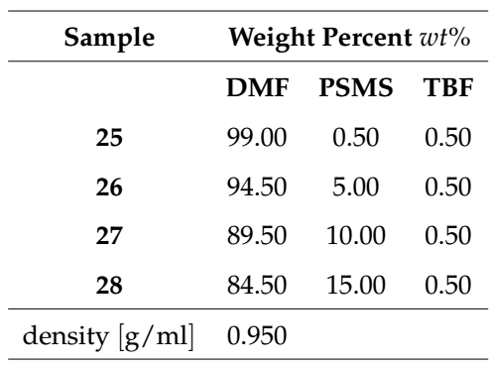
Methods: Sample Preparation (PSB & PSMS)

Slide 36
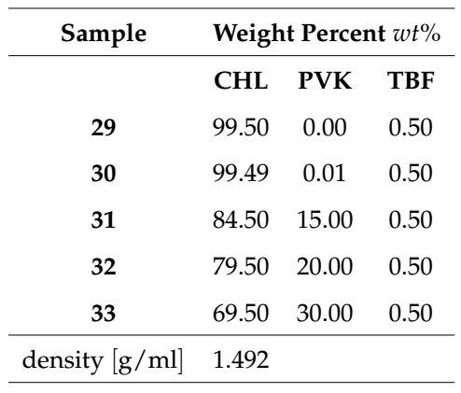

Methods: Sample Preparation (PVK & SU8-PVK)

Slide 37


Methods: Rheology – Frequency Sweeps
Geometry:
Steel cone plate, Peltier plate
(60.0 mm diameter, 0.9979° cone angle, 23 µm truncation)
Procedure:
Frequency sweep
(20°C, for 20 min
from ${10}^{−3}$ to ${10}^{4}$ 1/s shear rates)

Slide 38



Methods: The Carreau-Yasuda Model
$$η=\frac{η_{0}−η_{∞}}{{\left[1+{\left(κ\dot{γ}\right)}^{a}\right]}^{\frac{1−n}{a}}}+η_{∞}$$
$η$: viscosity
$\dot{γ}$: shear rate
$η_{∞}$: infinite shear rate viscosity
$η_{0}$: zero shear rate viscosity
$κ$: time constant
$n$: Power Law index
$a$: width of the transition region

Slide 39


Methods: Other models:

Slide 40


Methods: Other models:

Slide 41




Methods: Rheology results validation for 0wt% PEO
from PEO in SU8 sample set
Measured:
$$\left(8.05±0.28\right) mPa⋅s$$
vs.
MicroChem data sheet:
$$\frac{7.5cSt \left(1.123g/ml\right)}{1000cSt⋅s⋅m⋅g/ml⋅Kg}=8.422 mPa⋅s$$
from PVK in SU8 sample set
$$1.09 \%error$$
Microchem, Su-8 2000.5, 2002, 2005, 2007, 2010, 2015, Microchem. (2018) 1–5. papers3://publication/uuid/859F51B9-0382-4DE8-88A9-267F936939A3.

Slide 42




Methods: Rheology results validation for 0wt% PEO
Measured:
$$0.499 mPa⋅s$$
vs.
Anton-Paar data sheet:
$$0.563 mPa⋅s$$
$$11.36 \%error$$
https://wiki.anton-paar.com/en/chloroform/

Slide 43


D.R. Flores, Role of rheological properties in near field electrospun fibers morphology, (2017) 130.
Notes:
D.R. Flores, Role of rheological properties in near field electrospun fibers morphology, (2017) 130.

Slide 44

Methods: Rheology results validation
D.R. Flores-hernandez, B. Cardenas-benitez, S.O. Martinez-chapa, J. Bonilla-rios, Tailoring the Diameters of Electro-Mechanically Spun Fibers by Controlling Their Deborah Numbers, (2020). https://doi.org/10.3390/polym12061358.
Notes:
D.R. Flores-hernandez, B. Cardenas-benitez, S.O. Martinez-chapa, J. Bonilla-rios, Tailoring the Diameters of Electro-Mechanically Spun Fibers by Controlling Their Deborah Numbers, (2020). https://doi.org/10.3390/polym12061358.

Slide 45

Methods: Rheology results validation
G.S. Bisht, G. Canton, A. Mirsepassi, L. Kulinsky, S. Oh, D. Dunn-Rankin, M.J. Madou, D. Dunn-Rankin, L. Kulinsky, A. Mirsepassi, G.S. Bisht, S. Oh, G. Canton, Controlled Continuous Patterning of Polymeric Nanofibers on Three-Dimensional Substrates Using Low-Voltage Near-Field Electrospinning, Nano Lett. 11 (2011) 1831–1837. https://doi.org/10.1021/nl2006164.
Notes:
D.R. Flores-hernandez, B. Cardenas-benitez, S.O. Martinez-chapa, J. Bonilla-rios, Tailoring the Diameters of Electro-Mechanically Spun Fibers by Controlling Their Deborah Numbers, (2020). https://doi.org/10.3390/polym12061358.

Slide 46

Spinnable/Critical Concentration
non-spinnable concentrations
spinnable
concentrations
c*=25 wt%

Slide 47

Spinnable/Critical Concentration

Slide 48


Spinnable/Critical Concentration
Vu Anh Doan et al. “Interphase transfer of tackifier between poly(butadiene) and poly(styrene-co-butadiene)”. In: Journal of Materials Science 48.5 (Mar. 2013), pp. 2046–2052. ISSN: 0022-2461. DOI: 10.1007/s10853- 012- 6974- 1. URL: http://link.springer.com/10.1007/s10853-012-6974-1.
Ralph H. Colby, Lewis J. Fetters, and William W. Graessley. “The melt viscosity-molecular weight relationship for linear polymers”. In: Macromolecules 20.9 (Sept. 1987), pp. 2226–2237. ISSN: 0024-9297. DOI: 10 . 1021 / ma00175a030. URL: https : / / pubs . acs . org / doi / abs / 10 . 1021 / ma00175a030.

Slide 49

POLYSTYRENE
TETRAHYDROFURAN
c*

Slide 50

POLY(STYRENE-CO-BUTADIENE)
1-METHYL-2-PYRROLIDINONE
c*

Slide 51

POLY(STYRENE-CO-BUTADIENE)
75% TETRAHYDROFURAN / 25% N,N-DIMETHYLFORMAMIDE
c*

Slide 52

POLY(STYRENE-CO-ALPHA-METHYLSTYRENE)
N,N-DIMETHYLFORMAMIDE
c*

Slide 53

POLY(9-VINYLCARBAZOLE)
CHLOROFORM

Slide 54

POLY(9-VINYLCARBAZOLE)
DICHLOROMETHANE

Slide 55



Conclusion2.1: Polymer-Solvent concentrations
Polymer / Solvent | Critical / spinnable concentration | Molecular Weight
Poly(Ethylene Oxide) / SU-8 Cyclopentanone | 0.25 wt% | 4 000 000
Polystyrene Tetrahydrofuran | 15.17 wt% | 192 000
Poly(Styrene-co-Butadiene) 1-Methyl-2-Pyrrolidinone | 7.74 wt%
Poly(Styrene-co-Butadiene) 75% THF / 25% DMF | 13.75 wt%
Poly(Styrene-co-α-Methylstyrene) N,N-Dimethylformamide | 4.94 wt%
Poly(9-Vinylcarbazole) Chloroform | 0.75 wt% | 1 100 000
Poly(9-Vinylcarbazole) / SU-8 Cyclopentanone | 15.0 wt% | 1 100 000
Notes:
Note Mw of each polymer

Slide 56
Fabrication & Characterization

Slide 57

Methods: Design of experiments / NFES
Given the results of previous work, the experiments shall reflect:
The SU8-PEO sample set is the control
The critical concentration will be used for each sample set
Other process parameters (working distance, stage velocity, flow rate) are to be tuned and remain constant during NFES.

Slide 58




Conclusion3.1: spinnable solutions
Fabrication velocity: 1000um
Acceleration: 500mm/s^2
Working distance: 1500um
Applied voltage: 600V
Applied current: 15uA
Deposition rate: 0.3uL/min
Spacing: 10um
Polymer / Solvent | Critical / spinnable concentration
Poly(Ethylene Oxide) SU-8 | 0.25 wt%
Polystyrene Tetrahydrofuran | 15.17 wt%
Poly(Styrene-co-Butadiene) 75% THF / 25% DMF | 13.75 wt%
Poly(9-vinylcarbazole) Chloroform | (15.00 wt%)

Slide 59
Conclusion3.1: non-spinnable solutions
Polymer / Solvent | Critical / spinnable concentration | rationale
Poly(Styrene-co-α-Methylstyrene) N,N-Dimethylformamide | 4.94 wt% | Fibres were broken into agglomerates / dust
Poly(9-vinylcarbazole) Dichloromethane | (15.00 wt%) | Fast volatilization, creating a Shell around the drop.
Notes:
Poly(Styrene-co-Butadiene)
1-Methyl-2-Pyrrolidinone
7.74 wt%

Slide 60
Next Steps < work pending >

Slide 61


Prediction of Fibre diameter and characterization of fibres
vs.

Slide 62





Slide 63


Slide 64


SU-8 (MicroChem, US)
Notes:
https://rsc.aux.eng.ufl.edu/_files/msds/309.pdf

Slide 65
Carbon nanostructures via Lithography
The production of C-MEMS:
Polymer patterning through photolithography electrospinning
Carbonization through pyrolysis
● SU-8 Waste
● Physical & Optical Limitations
● Structure Limitations
photolithography process

Slide 66

TPP – Two-Photon Polymerization
B. Cardenas-Benitez, C. Eschenbaum, D. Mager, J.G. Korvink, M.J. Madou, U. Lemmer, I. De Leon, S.O. Martinez-Chapa, Pyrolysis-induced shrinking of three-dimensional structures fabricated by two-photon polymerization: experiment and theoretical model, Microsystems Nanoeng. 5 (2019). https://doi.org/10.1038/s41378-019-0079-9.

Slide 67


Characterization of the 0.25 wt% PEO Solution
Notes:
Surface t-

Slide 68


Slide 69







wt% in NMP
wt% in THF & DMF
wt% in DMF
wt% in THF
wt% in CHL
wt% in DCM

Slide 70



Slide 71



Characterization of the 0.25 wt% PEO Solution
Electrospun-able with an applied voltage of 600V.
Unable to initiate the jet at 200V or lower.
600V
700V
Notes:
Surface t-

Slide 72




Slide 73



Slide 74



SU-8 (MicroChem, US)
https://www.fishersci.com/shop/products/NC9901158/nc9901158#?keyword=SU-8++developer
https://www.fishersci.com/shop/products/NC0702370/nc0702370#?keyword=MICROCHEM+CORP+PHOTORESIST+SU-8
Notes:
https://rsc.aux.eng.ufl.edu/_files/msds/309.pdf

Slide 75

Materials

Slide 76
title:
<a point>
<another point>
<content> <key concept> <key concept>
D.R. Flores-hernandez, B. Cardenas-benitez, S.O. Martinez-chapa, J. Bonilla-rios, Tailoring the Diameters of Electro-Mechanically Spun Fibers by Controlling Their Deborah Numbers, (2020). https://doi.org/10.3390/polym12061358.

